Slide 1
Structural Equation Modeling

Slide 2
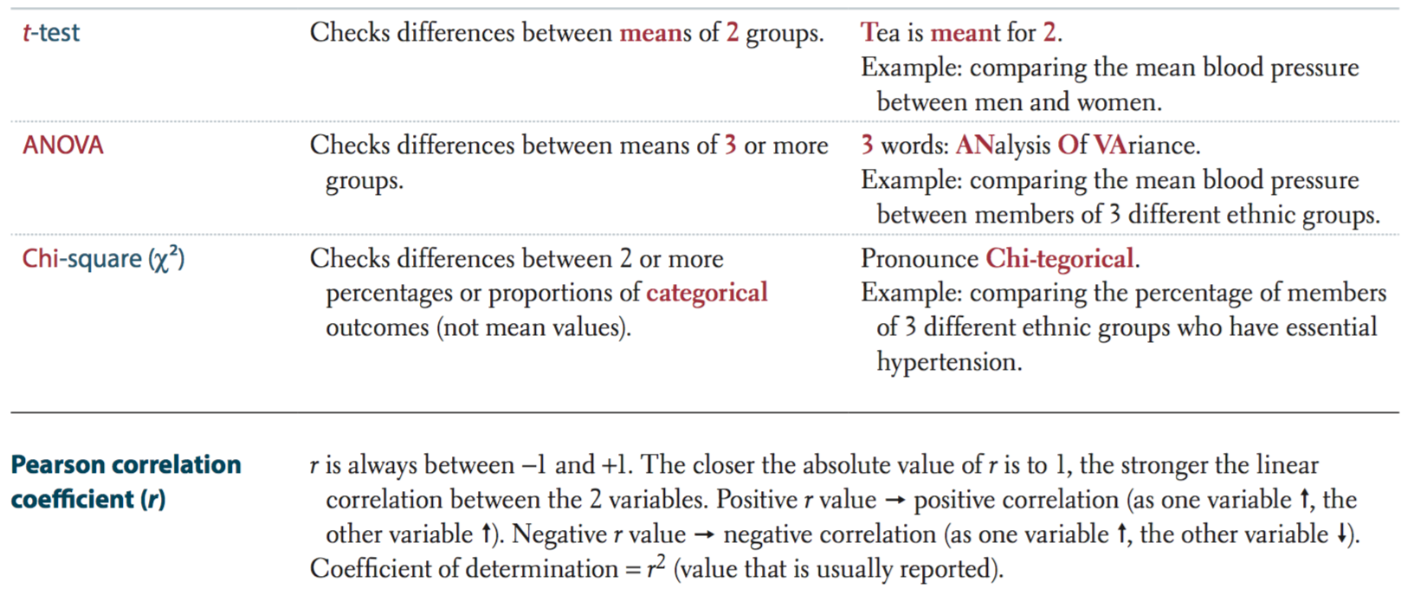
Statistics | The black box approach

Slide 3
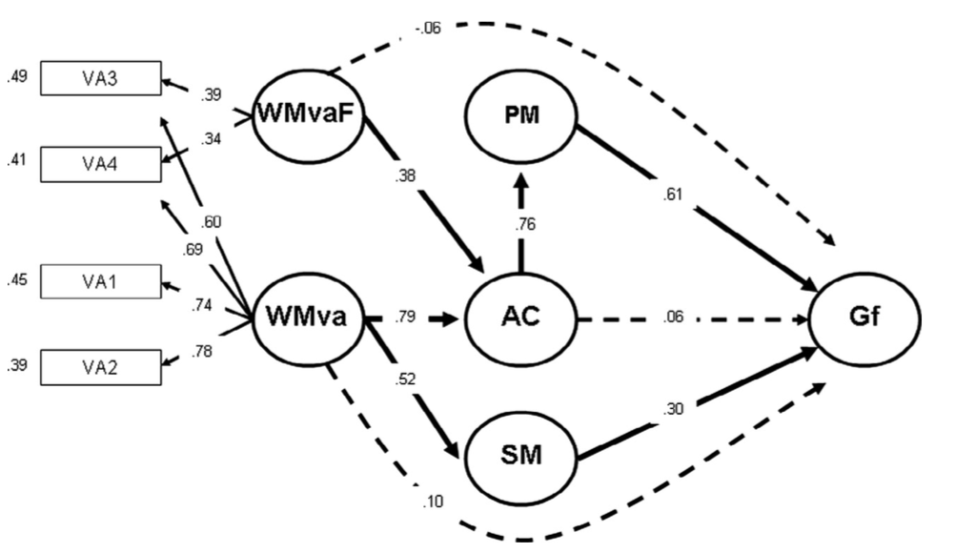
Statistics | Structural Equation Modeling

Slide 4
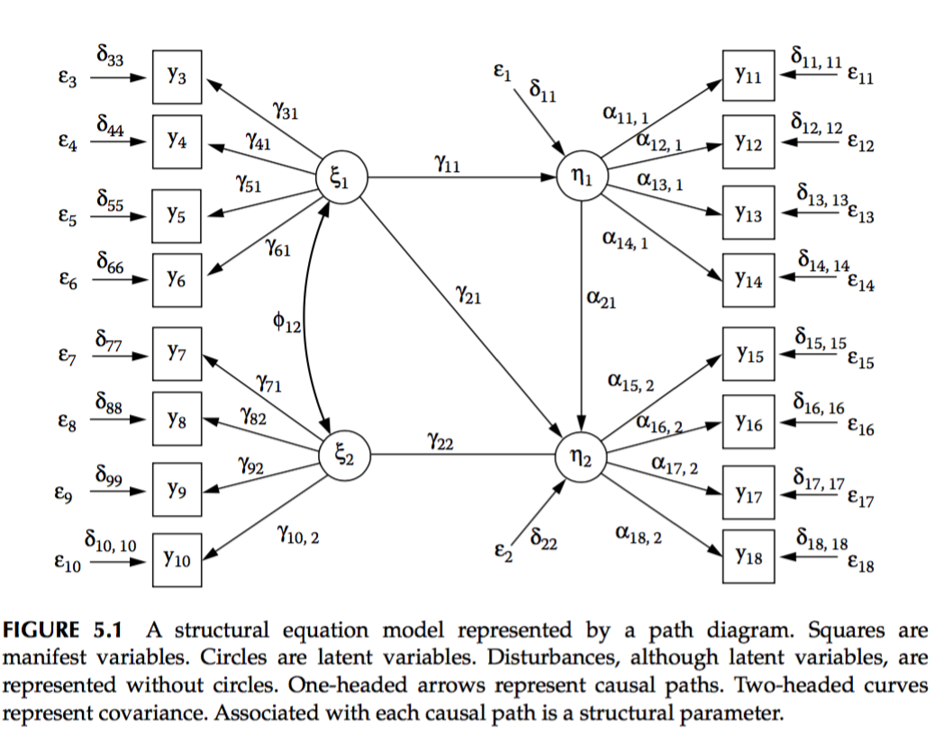
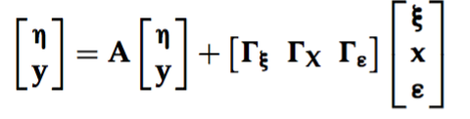
Statistics | Structural Equation Modeling
Endogenous variables = A * endogenous variables + G * (exogenous variables + exogenous noise)

Slide 5
Vocabulary| Variables
Exogenous variables
Variables whose variability is NOT explained by any variables in a model, and represent causal inputs into the system of variables.
In linear regression, the independent variables are exogenous variables
Endogenous variables
Variables whose variability is explained by one or more variables in a model
In linear regression, the dependent variable is the only endogenous variable
Manifest variable
Variable that is measured directly
Latent variable
Variable that is not measured directly, but represent a common source of variance of manifest “indicator” variables (e.g measurements on different types of thermometers are indicators of the latent physical concept of temperature)
Disturbance variable
Extraneous influence (source of variance) that explains part of the variance of one variable
Could contain systematic or random “error” (e.g unseen variable, or measurement error)
Key assumption : Assumed to be uncorrelated with other exogenous variables

Slide 6
Statistics | Classic GLM
Stats rely on linear regression
F(D) = aX + bY + cZ + error
a
b
F( )
c
F() is the link function, not used in basic stats

Slide 7
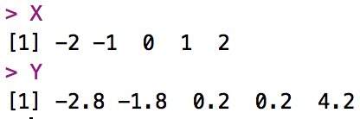
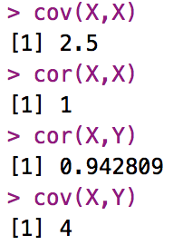
Statistics | Slightly opening the box
What about covariance MATRICES??
Scalar
Unit of variance
Unitless scalar
Between -1 and 1
Does not scale with variables

Slide 8
Statistics | The Matrix
X Y Z
Subject 1
Subject 2
Default
By convention
In R: t(A)

Slide 9
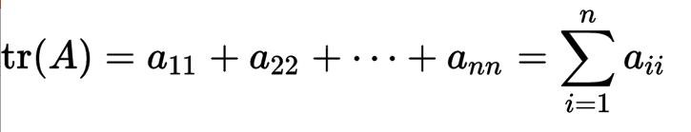
Statistics | The Matrix
A * I = A

Slide 10
Statistics | The Matrix
Very powerful mathematical tool with varying degree of complexity
Most basic use : solving linear equations
Linear equation : Ax = b
A⁻¹
A
x
b
2 unknowns
2 equations
3x₁ + 3.2x₂ = 118.4
3.5x₁ + 3.6x₂ = 135.2
No division in matrix form, you need to compute the inverse of A : A⁻¹
AA⁻¹ = A⁻¹A = I
Ax = b
A⁻¹Ax = A⁻¹b
x = A⁻¹b
AA⁻¹ = I

Slide 12
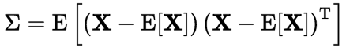
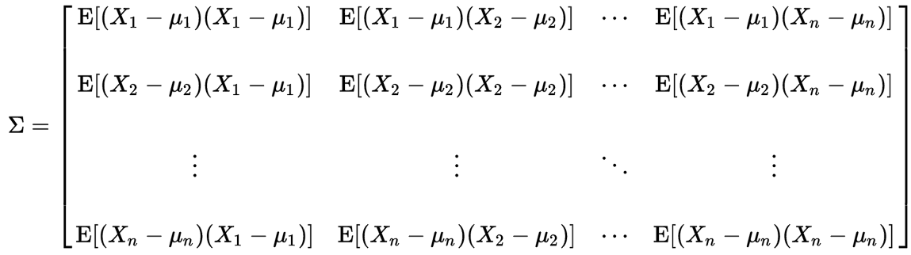
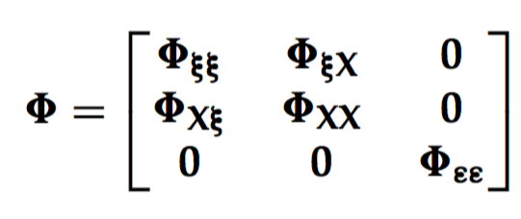
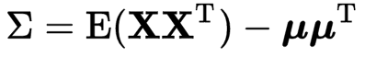
Statistics | The Matrix Reloaded
The variance-covariance matrix :
SEM
the very important
exogenous covariance matrix :
Variance
Generalization in higher dimension of the concept of variance (from scalar to matrix)
Diagonal elements of Σ form the vector the variances for each element of X
The trace of Σ is the classic scalar variance of X

Slide 13
Statistics | Overview
Problem
Inferences
Predictions
Model validation : Causality / Correlation
Characteristics
Overdetermined system : More equations than unknowns, almost always no solution
Real system : Measurement errors
Hidden variables : not known or impossible to measure
The system needs to be approximated: regression ! → USES COVARIANCE
Covariance is used to describe the system
Usual assumptions of multiple regression
Variables follow an unbounded normal distribution (skew, kurtosis)
Variables are uncorrelated (multicollinearity problem)
Error is normally distributed : No systematic measurement error
Homoscedasticity : error is uncorrelated to the predictor
Error variance is equally shared in error terms for all predictors

Slide 14
.
Statistics | System of equations
Overdetermined
Each row is an observation :
Here y and x are equivalent to beta in regression.
No solution is found for this system.

Slide 15
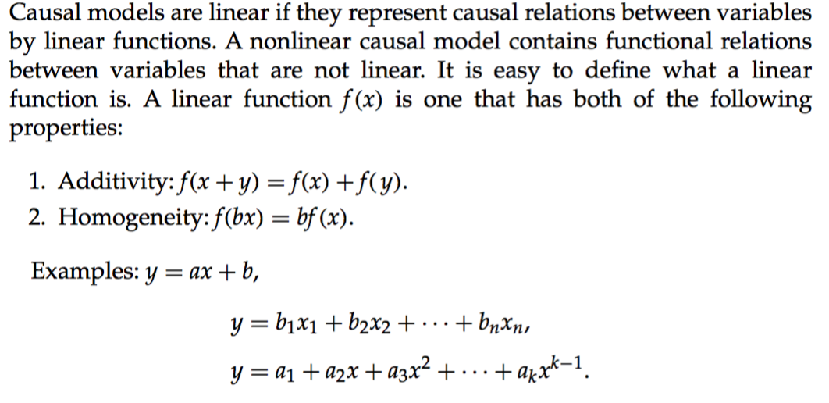
Statistics | Statistical Modeling
Linear
Non linear

Slide 16
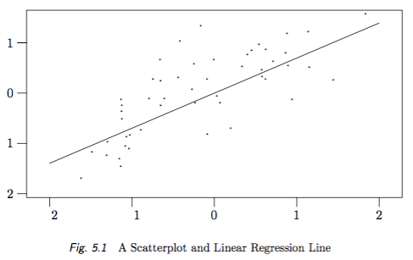
Statistics | System of equations
Linear system
(all regression variable appear with degree one)
Non linear system
(determined if polynomial same degree as number of observation)
Two problems
1 - How do you find b1 in a overdetermined model with no exact solution ?
2 - Is b1 significative ?
Y = b₀ + b₁ * x + ε
y = b + f(x) + f(x²) + f(x³) + … + f(x^{n}) + ε
y (x1+x2) != y(x1) + y(x2)
Other non linear system : e.g Y = b* e^{x}

Slide 17
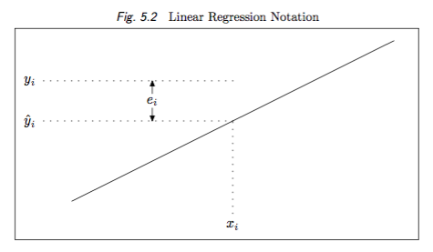
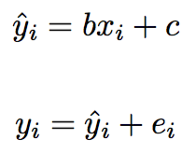
“Real” model
Statistics | Regression
β
Objective of regression : approximate the best possible betas to predict Y
residuals
If b is an approximate of β, residual e is an approximate of “real” error ε

Slide 18
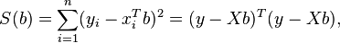
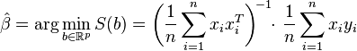
Statistics | Regression
Problem of over determined system : more equations than unknowns
Model the system: ERRORS OF APPROXIMATION (residuals)
residuals_{i} = real value_{i} – predicted model value_{i}
Solution = Optimization : minimize error (residuals) assumed to be NORMALLY distributed and uncorrelated
Ordinary least squares
Objective function (the one to minimize)
For one predictor :
Covariance(predictors, predicted) /
variance(predictor) !
Well… almost (for univariate centered data)
Matrix form for multiple predictors :

Slide 19
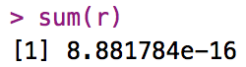
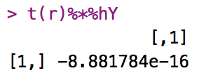
Statistics | Regression
β
β
β
Propriety of residuals :
Sums to 0
Orthogonal to the projected vector Yhat
~= 0
~= 0
Notes:
\begin{vmatrix}X & Y\\1 & 5\\ 2 & 6\\ 3 & 8\\ 4 & 8\\ 5 & 12\end{vmatrix}

Slide 20
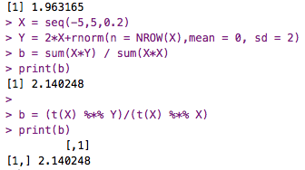
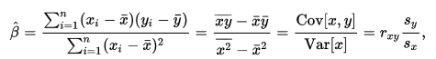
Y = 2*X + e
Statistics | Ordinary Least Squares
“real” error ε
Real β
X*Y
X^2

Slide 21
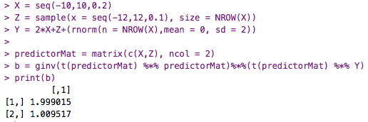
Y = 2*X + Z + e
Statistics | Multivariate regression
More predictors always gives an equal or better fit!
Risks : overfit, multicolinearity

Slide 22
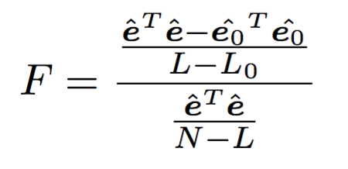
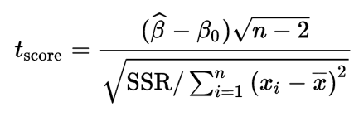
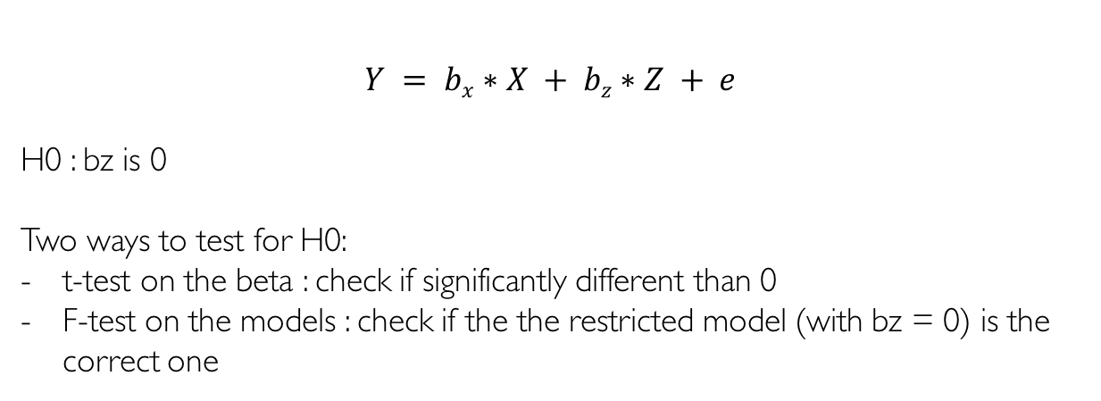
Statistics | Model testing
$$Y = bx∗X + bz∗Z + e$$
H0 : bz is 0
Two ways to test for H0:
t-test on the beta : check if significantly different than 0
F-test on the models : check if the the restricted model (with bz = 0) is the correct one
N = number of observations
L = number of regressor in full model
L0 = number of regressor in restricted model
Follows a t-distribution with n−2 degrees of freedom if the null hypothesis is true (in regression test if B is not significantly different from 0)
Follows a F distribution derived from Chi-2
If you reject H0 it means the amount of error you are making with the restricted model is significantly higher than with a more complete model
Notes:
SSR = Total sum of squares

Slide 23
Statistics | Regression
Characteristics
Linear combination of observed independent variables predict one observed dependent variable
More equations (subjects) than unknowns (predictors) : no solution
What are you testing
Whether the weight of the predictor is different from 0 (t test)
Whether the residual error of a restricted base model is different from a more complete model (F test)
Limits
No room for measurement errors on the predictors
Predictors interactions are not modeled
Only direct effects are modeled

Slide 24
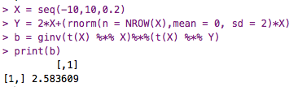
Statistics | Assumption on error
Error correlated with X
Linear least squares is the best linear estimator on certain assumptions
Error is normally distributed with mean 0 and finite variance
Homoscedasticity : standard deviation of the error term is the same whatever the value of the predictor
Error terms uncorrelated with each other
Notes:
TSS = ESS + RSS if and only if . The left side of this is times the sum of the elements of y, and the right side is times the sum of the elements of , so the condition is that the sum of the elements of y equals the sum of the elements of , or equivalently that the sum of the prediction errors (residuals) is zero.

Slide 25
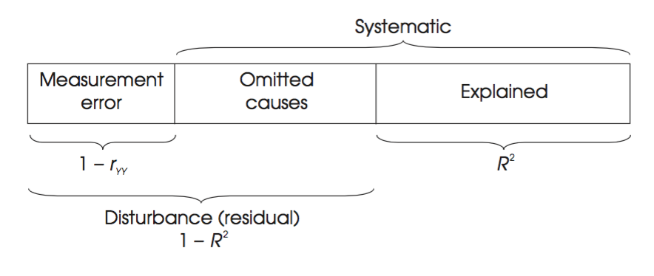
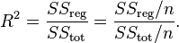
Statistics | Explained variance
Dependent variable deviation as sum of predictors deviations
Goodness of fit is generally defined as :
How well does your model reproduce the variance of your variable ?
Notes:
TSS = ESS + RSS if and only if . The left side of this is times the sum of the elements of y, and the right side is times the sum of the elements of , so the condition is that the sum of the elements of y equals the sum of the elements of , or equivalently that the sum of the prediction errors (residuals) is zero.

Slide 26
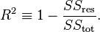
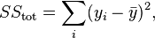
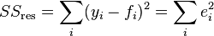
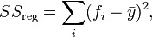
Statistics | Explained variance
Coefficient of determination:
If errors are normally distributed and centered on 0
(For univariate regression,
is the coefficient of correlation squared)
Notes:
TSS = ESS + RSS if and only if . The left side of this is times the sum of the elements of y, and the right side is times the sum of the elements of , so the condition is that the sum of the elements of y equals the sum of the elements of , or equivalently that the sum of the prediction errors (residuals) is zero.

Slide 27
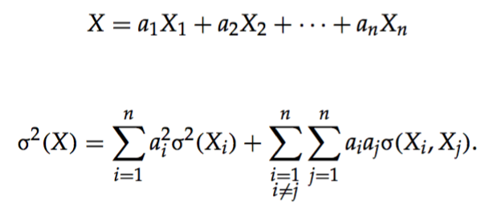
Statistics | Co-Variance
There are three fundamentally different ways in which two variables X and Y may co-vary. But all of these ways involve shared variance.
X → Y : X may be a cause of Y.
X ← Y: Y may be a cause of X.
X ← Z → Y: X and Y are not causes of each other but are effects of a common third variable Z.
We may expand these cases by replacing any arrow by a sequence of intervening variables with arrows between them all pointing in the same direction.
We may also consider that two variables may co-vary not only because one variable is the cause of the other, but additionally because there is some third variable that is a cause of both.
Variance of predicted variable :
Notes:
TSS = ESS + RSS if and only if . The left side of this is times the sum of the elements of y, and the right side is times the sum of the elements of , so the condition is that the sum of the elements of y equals the sum of the elements of , or equivalently that the sum of the prediction errors (residuals) is zero.

Slide 28
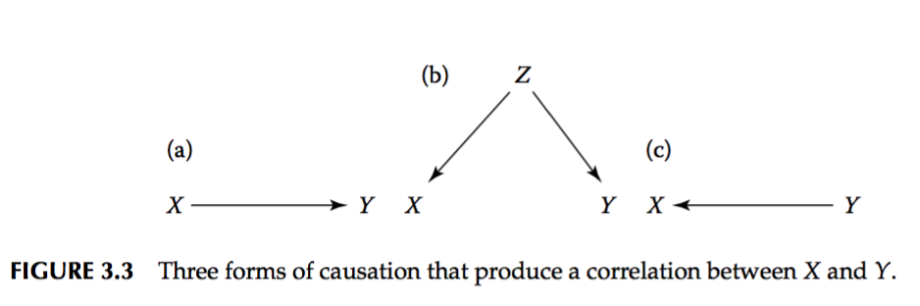
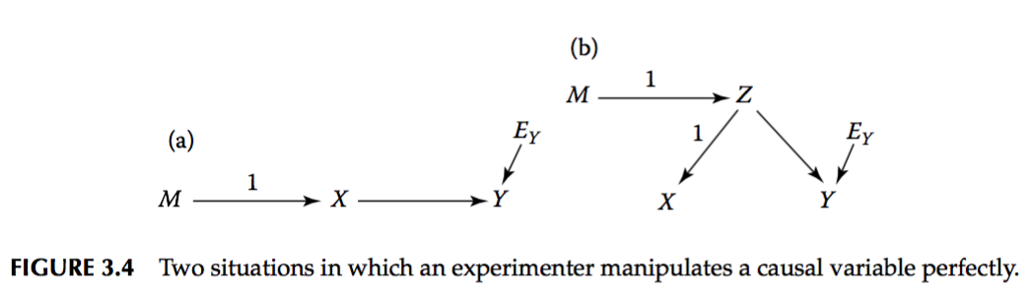
Statistics | Statistical Modeling
Use of instruments to conclude :
smoking
health
Tabacco taxes

Slide 29
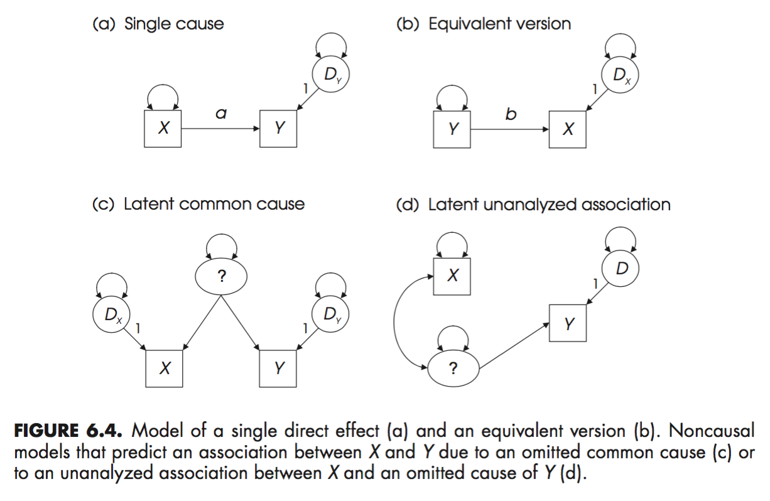
Statistics | Statistical Modeling

Slide 30
Statistics | Partial Correlation
X Y Z
You have N=3 subjects and measure 3 variables X, Y, and Z :
Y varies with Z
Z varies with X
If Z stays constant, does a variation of X affects Y ?
The desired partial correlation is then the cosine of the angle φ between the projections r_{X} and r_{Y} of x and y
onto the hyperplane perpendicular to z
Conditional correlation: does a third variable explains the observed correlation?
Precision matrix (inverse of covariance matrix) regroups conditional covariances
Vector representation of 3 samples of 3 variables

Slide 31
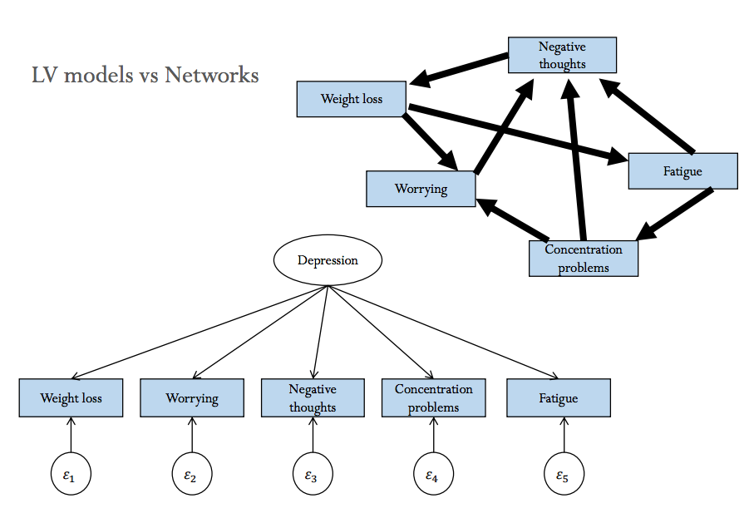
Statistics | Statistical Modeling
Latent common factor :
absorbs the “partial correlation”
Assumes to leave uncorrelated endogenous variables if fixed
If depression is fixed, endogenous variables are independent (error terms are independent)

Slide 32
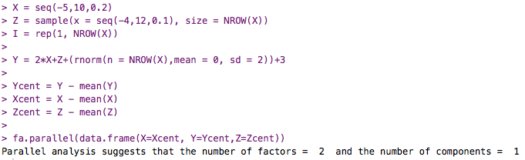
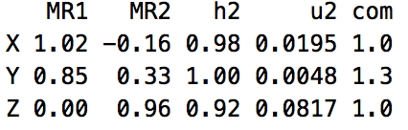
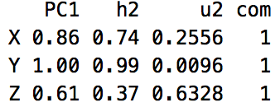
Statistics | Exploratory Factor Analysis
Scree plot
Sharp break
2 latent “co-varying” factors – 1 principal component
Shouldn't be done in this example since best practice is at least 4 indicators per latent variable (min 2) : risk Heywood cases
FA : regroup shared variance (2 factors : X and Z)
PCA: maximize component to absorb the most variance (Y)
PCA results in principal components that account for a maximal amount of variance for observed variables; FA account for common variance in the data.
Philosophically, components are weighted composites of observed variables while in the factor model, variables are weighted composites of the factors.

Slide 33
Statistics | Exploratory Factor Analysis
Unconstrained or Lightly constrained system (number of components in FA)
Primary Component Analysis
Rotated PCA
Factor analysis
Exploratory Factor Analysis
Confirmatory Factor Analysis
Constrained system
Compares variance-covariance matrix to the unconstrained model
Path analysis
Mediational analysis
Structural equation modeling

Slide 34
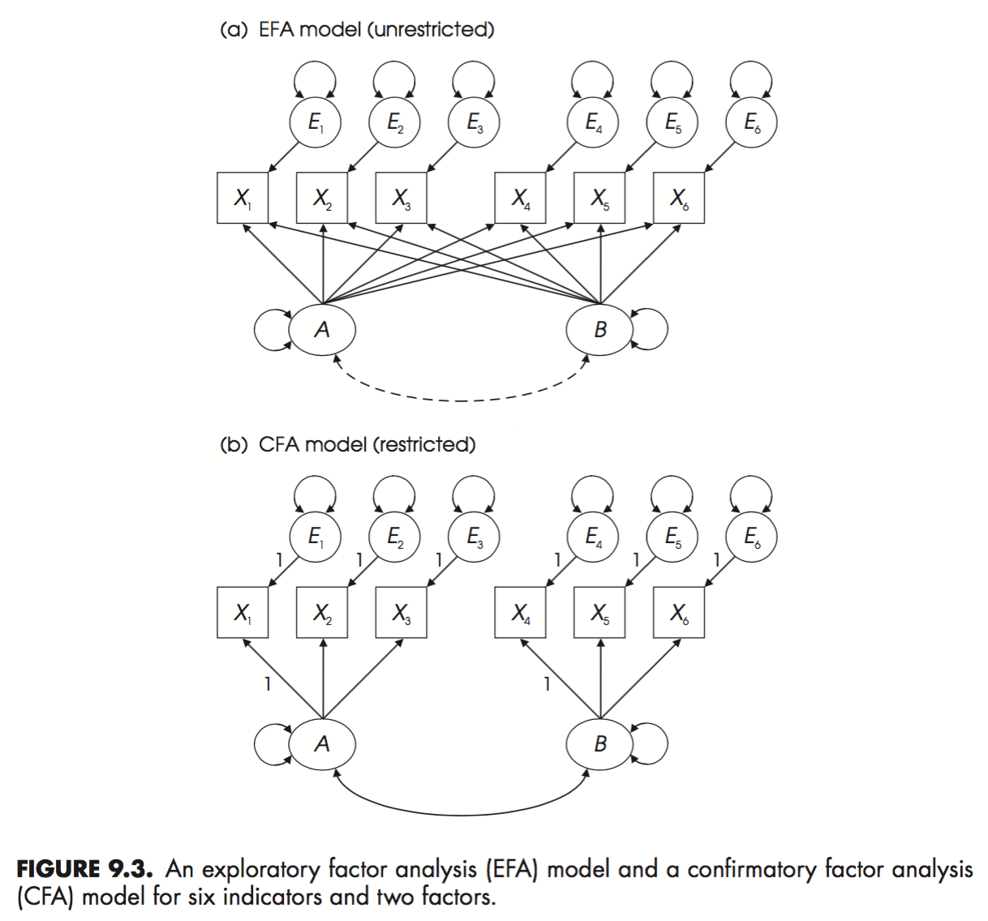
Statistics | Exploratory Factor Analysis
Certain relationship are constrained

Slide 35
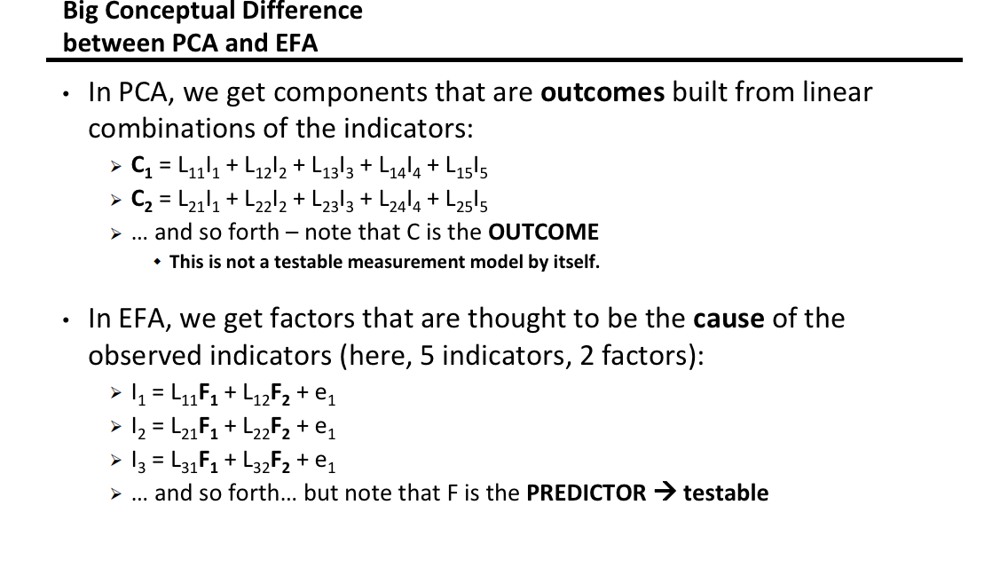
Statistics | Exploratory Factor Analysis

Slide 36
Vocabulary| Variables
Exogenous variables
Variables whose variability is NOT explained by any variables in a model, and represent causal inputs into the system of variables.
In linear regression, the independent variables are exogenous variables
Endogenous variables
Variables whose variability is explained by one or more variables in a model
In linear regression, the dependent variable is the only endogenous variable
Manifest variable
Variable that is measured directly
Latent variable
Variable that is not measured directly, but represent a common source of variance of manifest “indicator” variables (e.g measurements on different types of thermometers are indicators of the latent physical concept of temperature)
Disturbance variable
Extraneous influence (source of variance) that explains part of the variance of one variable
Could contain systematic or random “error” (e.g unseen variable, or measurement error)
Key assumption : Assumed to be uncorrelated with other exogenous variables

Slide 37
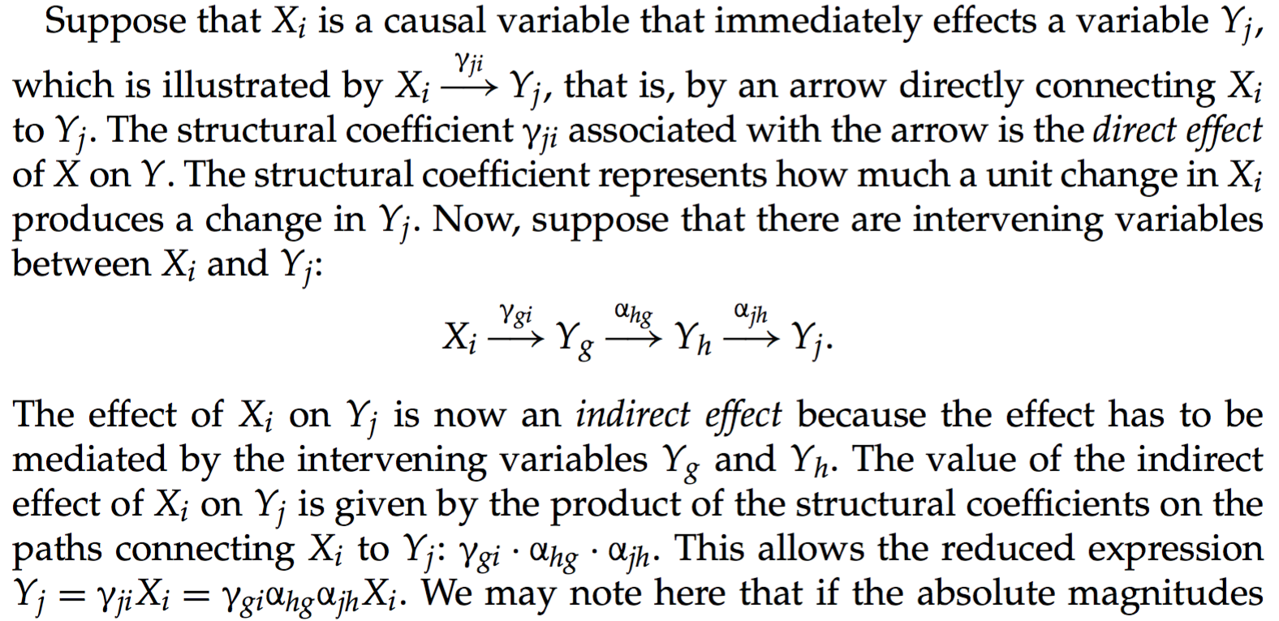
Vocabulary| Effects

Slide 38
Vocabulary| Error
Error is defined as the deviance from predicted values in a certain statistical model
Latent Exogenous
Non normality/Systematic
Another hidden correlated variable
Correlated measurement error
Normality
Measurement Error
Uncorrelated variable
Key assumption : Usual algorithms (ML, OLS) assume normally distributed error

Slide 39
Statistics | Classic GLM
F(D) = aX + bY + cZ + error
a
Latent
Exogenous
b
Manifest Exogenous
Manifest Endogenous
F( )
c
F() is the link function, not used in basic stats

Slide 40
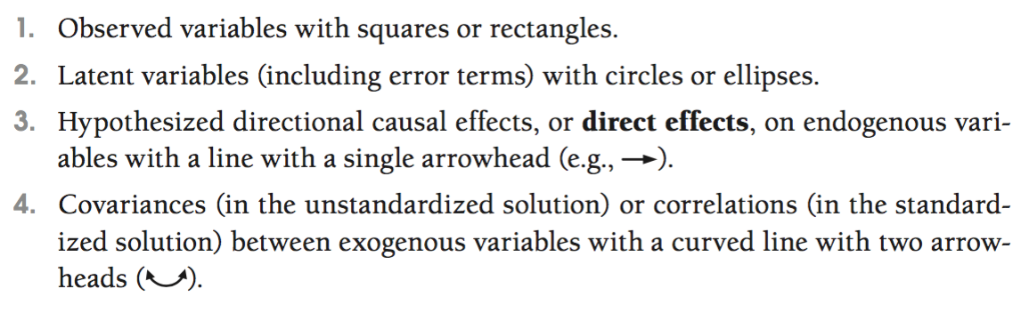
Statistics | Diagrams

Slide 41
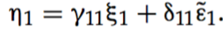
Statistics | Diagrams
Structural Model as a list of linear equations

Slide 42
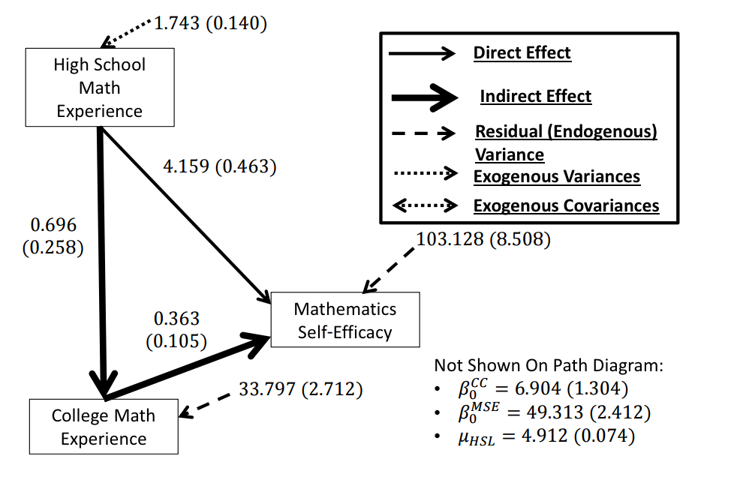
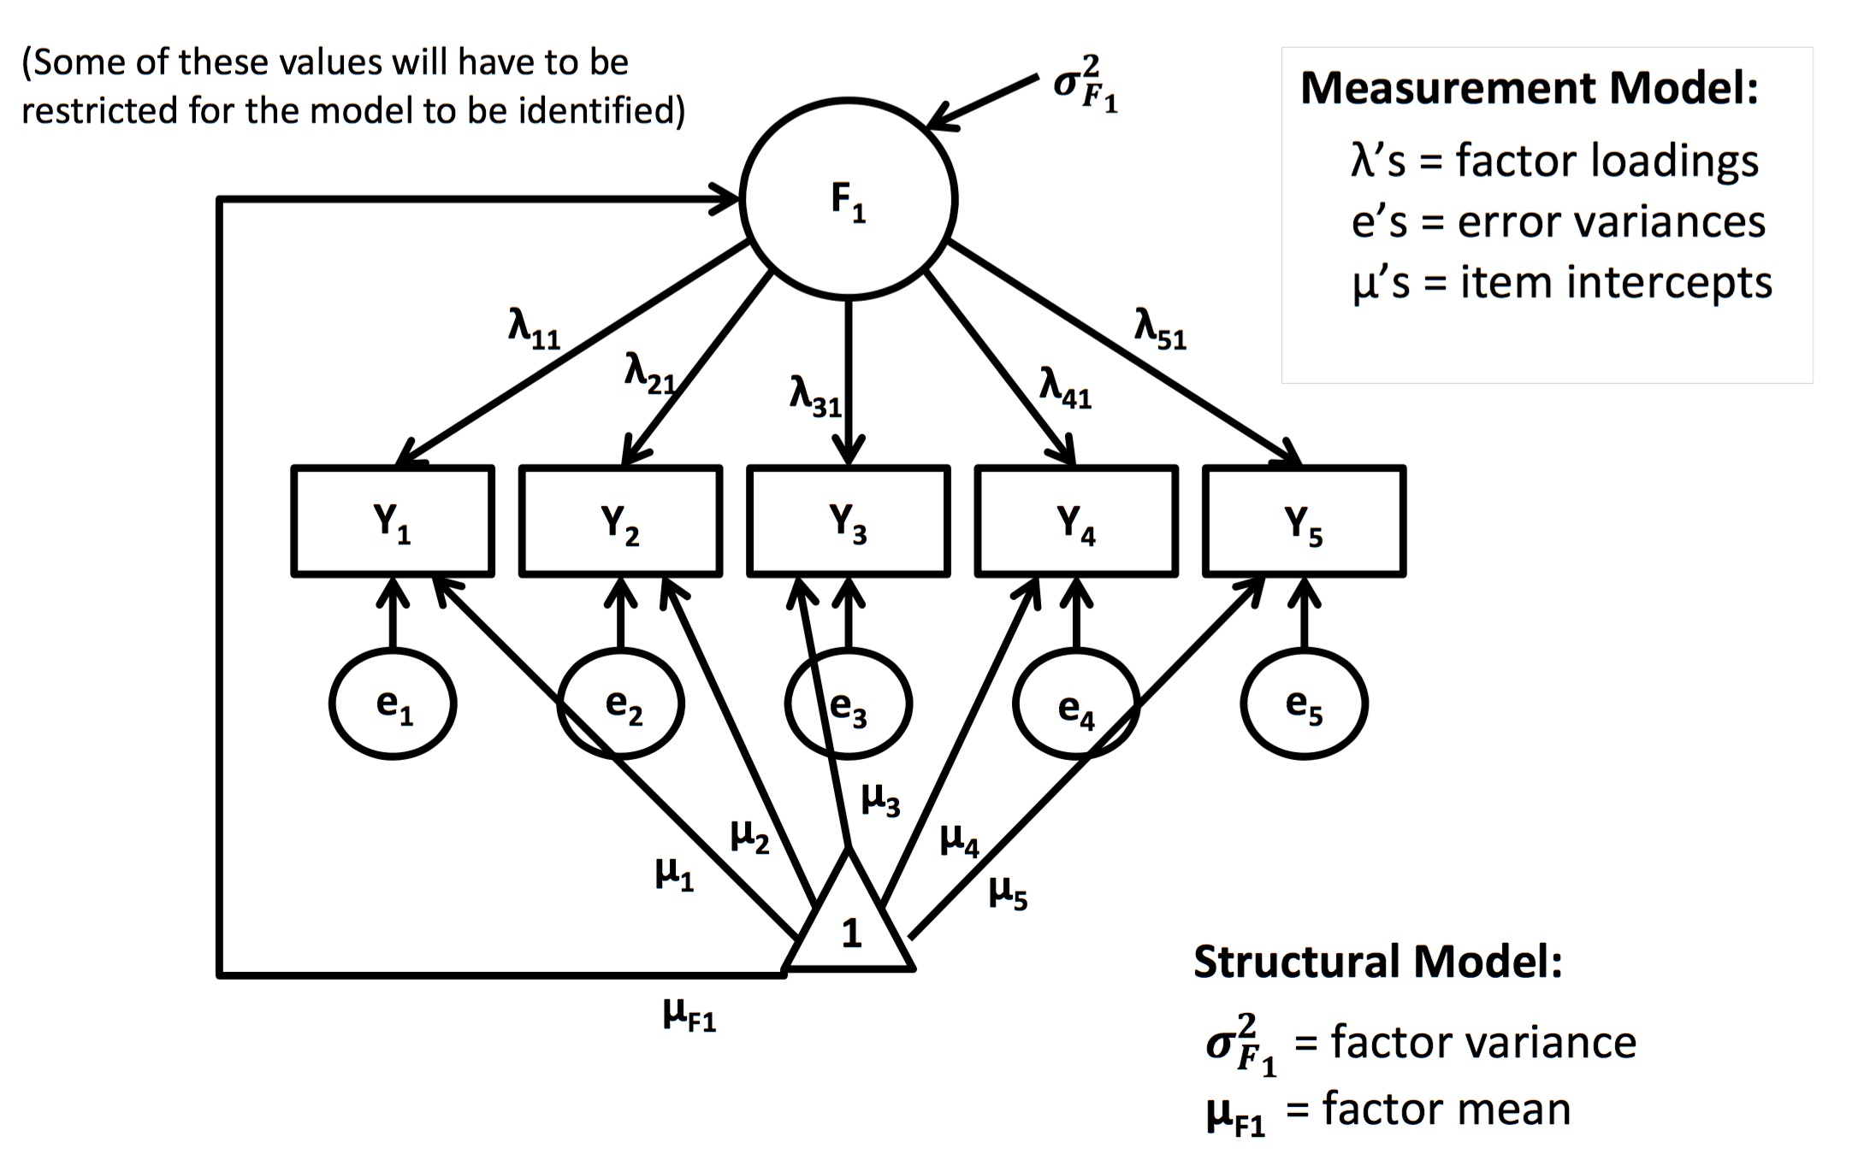
SEM| Path analysis + Confirmatory Factor Analysis
Path analysis (manifest variables)
CFA

Slide 43
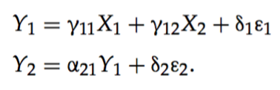
Statistics| SEM and Covariance
SEM permits to compare the observed variance–covariance matrix to the variance-covariance matrix of the model.
In order to get the variance–covariance matrix from the model, we need expressions that derive the variances and covariance among the variables of the model from the model equations for the observed and latent endogenous variables
Variance for exogenous variables is not “predicted” or constrained. SEM is constraining variance of endogenous variables only.
Example:
Ys are endogenous, Xs exogenous. We wrote endogenous variance in terms of exogenous variance.

Slide 44
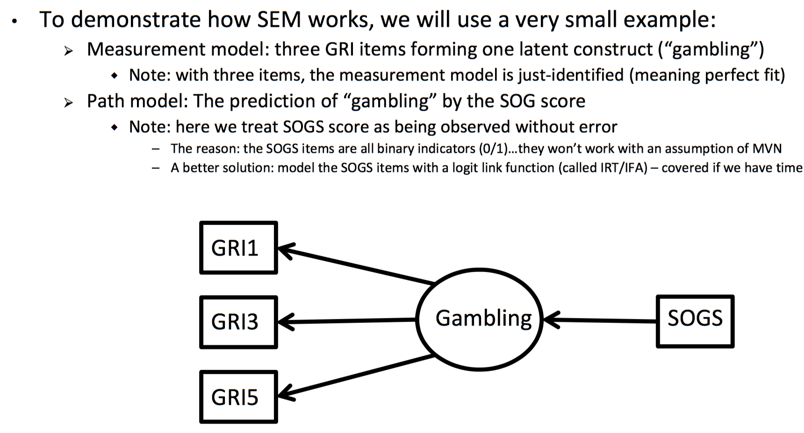
Example 1
SEM| Path analysis + Confirmatory Factor Analysis

Slide 45
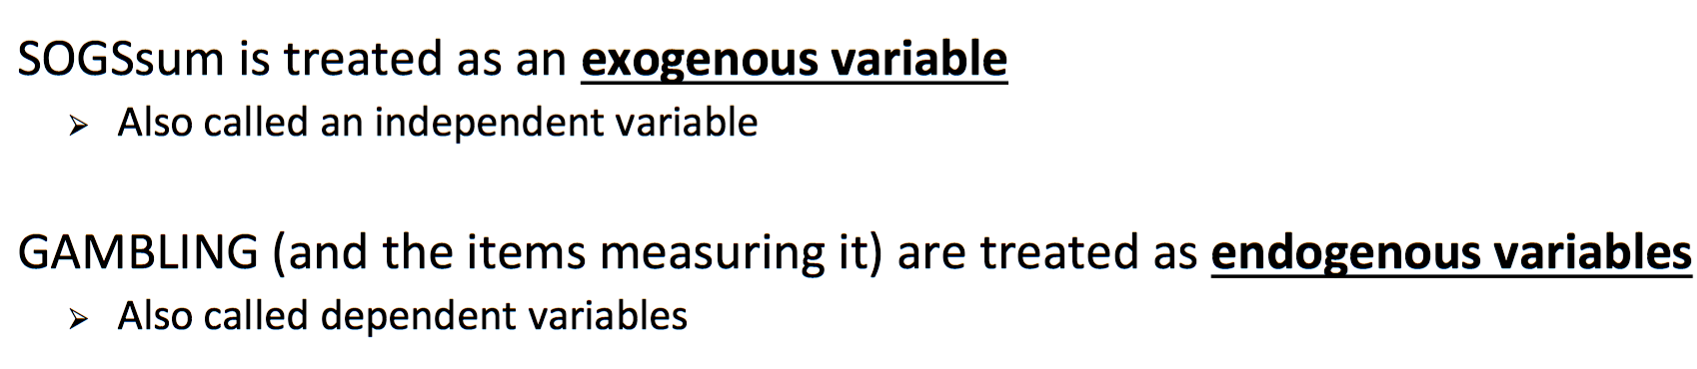

Example 1
SEM| Path analysis + Confirmatory Factor Analysis

Slide 46



Example 1
SEM| Formulas
Y = Manifest Endogenous
X = Manifest Exogenous
Manifest endogenous
Latent endogenous

Slide 47

SEM| The Matrix

Slide 48

Example 2
SEM| Path analysis + Confirmatory Factor Analysis
Multiple testing
Effect of math courses after 2 years of college on a math abilities

Slide 49


Max. Likelihood| Statistical Estimator
Univariate normal

Slide 50

Univariate normal
Max. Likelihood| Likelihood function

Slide 51


Multivariate normal
Max. Likelihood| Likelihood function

Slide 52

Multivariate normal
Max. Likelihood| Likelihood function

Slide 53

Multivariate normal
Max. Likelihood| In SEM

Slide 54



Multivariate normal
Max. Likelihood| Parameters estimation
Convergence
Starting
values
Newton Method
Gradient Descent
Iterative method : Newton-Raphson/Gradient Descent
*follow the derivative !

Slide 55



Max. Likelihood| Assumptions
BUT Robust ML algorithms exist !
(e.g MLR)
heteroskedatic
Skewed

Slide 56

SEM| Assumptions
4 manifest variables per latent variables :

Slide 57
SEM| Assumptions
What are the data-related requirements for SEM?
Meet the assumptions of the model estimator you have selected, e.g Multivariate normality is the a central assumption when using Maximum-Liklihood, look at skewness and kurtosis values
100-150 observations might be enough, but sample size needs will increase as models become more complex, and/or as the reliability/validity of the variables used in the model decreases.
And even if data depart from assumed properties, a researcher could consider the use of a "robust" estimator (Finney & DiStefano, 2008), or an estimator that assumes a different kind of data (e.g., a categorical estimator, like diagonally weighted least squares).

Slide 58
SEM| Model Comparison
Various measures of fit, all based on the distance of the modeled covariance matrix to the observed variance matrix.
Some of them control for the sample size, and the complexity of the model (number of indicators)
Usually it is common to present several of them. Each author having their favorite ones apparently.
The main measures :
Chi squared = sum( (observed – expected)² / expected)
AIC = 2 * number of parameters – 2 * ln (likelyhood)
BIC = 2 * number of parameters * ln (number of observation) – 2 * ln(likelyhood)
Root mean squared error of approximation
Standardized root mean residual
Comparative Fit Index
Notes:
Several fit statistics are reported for each model. In addition to reporting chi-square (v2) and remaining degrees of freedom (df), v2/df served as a ‘‘badness-of-fit’’ statistic. Values above 2 are assumed to reflect a significant difference between the observed and reproduced covari- ance matrices. Additional statistics include root mean square error of approximation (RMSEA), which estimates the model fit to the population, and standardized root mean square residual (SRMR), which reflects average devi- ation of the reproduced covariance matrix from the observed. For these indices, values below .05 are ideal, but up to .08 is acceptable (Browne & Cudeck, 1993; Kline, 1998). Non-normed fit index (NNFI) and comparative fit index (CFI) compare the hypothesized model relative to one in which observed variables are assumed to be uncor- related. For these statistics, values above .95 represent a good fit (Hu & Bentler, 1999). Model comparisons were made using change in v2 and change in Akaike’s (1987) information criterion (AIC). AIC is a measure of model par- simony which takes into account both goodness-of-fit and number of to-be-estimated parameters. If a path is added and this results in a smaller AIC value, then it can be said that the loss of parsimony is offset by improved explana- tory power.

Slide 59

An Example| Paper

Slide 60
Background| A Brief history of working memory
James 1890
Primary and secondary memory
1880-…
Rich panel of studies on memory.
Theory of memory as storage units, short term and long term memory, procedural/declarative…
Higher cognitive function makes demands on a limited capacity system and memory theorists assign this function to short term memory (STM).
Shiffrin, 1970: Cue-based search processes, Encoding-Retrieval context…
Baddeley and Hitch, 1974
Traditional STM measures do not correlate with measures of higher level functions such as reading, and reasoning.
A new functional approach is necessary to define the memory processes implicated in those higher level function, i.e a working memory paradigm.
A memory system that could simultaneously manipulate the current contents of memory as well as update information in memory to accomplish task goals.
They theorize three main components for WM :
A central executive (flexible workspace able to process information and command storage)
An articulary loop (auditory maintenance system)
And a visuo-spatial scratch-pad (visuo-spatial maintenance system)

Slide 61
Background| A Brief history of working memory
Various models of WM are theorized
All agree that WM can only maintain a certain amount of information, with the notion of working memory capacity, but the nature of this limit is subject to hot debates. A specific question is whether this limit is invariant within an individual or is it task dependant.
Daneman & Carpenter, 1980
Complex reading span measure : occupy the WM with reading processing while asked to remember the last word of the sentence.
Complex reading span better predicted reading comprehension than simple memory span task (word span) without secondary processing task, since then taken as measures of short term memory capacity.
Conclude that larger WM capacity might be due to better domain related processing strategy (e.g reading skills with word memory), leaving more room for storage – that is WM capacity is dependent on task proficiency.
1980-85
Although main hypothesis for WM is a domain specific skill-based system, some studies are trying to characterize a general trans-domain working memory, but with apparently poor correlation coefficients coming out, e.g correlation of higher level function like reading comprehension with reading span (high correlation) and counting span measures (low correlation) (Baddeley & Brereton, 1985)

Slide 62
Background| A Brief history of working memory
“Working Memory Capacity” Marilyn Turner, Randall Engle, 1986
Cross domain span task : operational span (remember words while processing arithmetic). Predict reading comprehension as well as complex reading span : complex span tasks measure a cross-domain WM capacity.
1985-…
WM studies show it correlates with various higher level functions, vocabulary learning , computer language learning, SAT and aptitude test etc..
Latent factor analysis used to classify WM tasks in terms on what “latent executive functions” loads on them, and relate measures to each other (visual arrays, star counting test, random generation...)
Various theories of “Primary Memory”
McElree 1989: Single chunk focus, Cowan 1995 : 4 chunks Focus of attention model, Baddeley 2000: Episodic buffer, Davelaar 2002: activation buffer
Oberauer, 2002 : WM model
Three components: the activated part of Long term memory, the region of direct access (~= cowan 4 chunks but as active binding model), and the focus of attention (selection function of units in DA ~= McElree single chunk focus)
Conway, Boyle , 2002
WM correlates with measures of fluid intelligence (Gf). With as much as 50% shared variance.

Slide 63
Background| A Brief history of working memory
Model used in the paper
Use of “Primary memory” and “secondary memory” to characterize two function of WM
Working memory is needed when control is needed to override automatic response tendencies.
Working memory fulfills two basic functions, maintenance and retrieval:
Maintenance is needed to keep new and novel information in a heightened state of activity, particularly in the presence of internal and external distraction. (primary memory)
Because the system is limited by how much information can be maintained at any given time, sometimes retrieval of that information in the presence of irrelevant information is required. To retrieve task relevant information, a discrimination process is needed to differentiate between relevant and irrelevant information on the basis of a combination of cues, particularly context cues. (secondary memory)
Role of attention is less clear : information filtering and maintain focus

Slide 64
Background| A Brief history of working memory
All in all
40+ years of task development, correlational studies, and latent factor analysis converging on a general model of WM and what a WM task is.
Moving from behavior to neurophysiological paradigms
Flexible resource allocation models (Bays), continuous scales tasks (Wilken & Ma), feature dimensions paradigms in fMRI studies (Vogel, Rigall), stimuli salience/perceptual decision making NHP electrophysiological studies, association with reward, etc.
Shared covariance with Gf is of great importance for the WM field :
“Among the theoretical constructs within current theories of information processing, WMC is the one parameter that correlates best with measures of reasoning ability, and even with gf and g. Therefore, investigating WMC, and its relationship with intelligence, is psychology’s best hope to date to understand intelligence.”
- Klaus Oberauer (vs Ackerman 2005)

Slide 65
Background| Authors
Zach Shipstead
Assistant Professor of Psychology, at Arizona State University.
Studies intentional remembering and forgetting and their role in complex cognition.
His working hypothesis :
Intentional remembering is a process that is primarily tapped by tasks traditionally used to measures individual differences in working memory capacity (the ability to remember critical information in the face of distraction).
Intentional forgetting is primarily tapped by tasks that are traditionally used to measure general fluid intelligence (the ability to reason with novel information).
In effect, these two processes allow a person to remain focused on important information, rather than being drawn into distraction or fixating on outdated information. The strong correlation between working memory capacity and fluid intelligence is thus explained by these processes being organized around the goals of top-down attention.
Randall Engle
Professor of Psychology at Georgia Tech and University of Edinburgh
Has been studying and modeling memory since his first 1970 paper : “Imagery and abstractness in short-term memory”. Has participated in the modern definition of working memory as an active functional process distinct from short term memory or another pure form of storage capacity.
Has been creating and refining tasks able to measure different aspects of working memory and in particular cross-modal complex span tasks.

Slide 66
Background| Working Memory
Ongoing
Processing
Relevant
information
Access Goal Relevant Information
Noise
Primary memory processes
Retrieval from secondary memory
?
?
?
Fluid Intelligence
Working Memory
Attentional control
σ = 50%
Focus of attention
Active filtering
Tasks
Manifest
Measures
Goal Oriented
Response
Tuning
Goals
Demands

Slide 67
Background| Article Definitions
Working memory
Executive function able to maintain access to goal oriented information
Three main mechanisms described in the paper as the building blocks of working memory :
primary memory information maintenance
secondary memory retrieval
and attention control
Measured by : dual-task paradigms that combine a short-term storage task with a processing task
Primary Memory
Protect relevant information from interference and allow novel associations to be formed.
Associated to the “size of a person’s Focal attention”
Theories:
Storage system able to hold 3-5 units of information protected from interference
Binding function whose efficiency forming and breaking bounds between information gives rise to the observable size of focal attention (*Oberauer compares it to the degree of parallel processing)
Measured by : simple span tasks, free recall ( < magic number 7)
Secondary Memory
Retrieves items displaced from PM
Cue-dependant probabilistic search and retrieval system in short term memory
Measured by : simple span tasks, free recall ( > magic number 7)

Slide 68
Background| Article Definitions
Attention control
Ability to filter out noise, to use attention to select relevant information from the environment
Fluid intelligence
Ability to reason with new information
Replicated result showing that working memory shares half of its variance with fluid intelligence

Slide 69
Working Memory| Problematic
What are the underlying cognitive mechanisms of working memory capacity ?
Validate a certain model of WM : Primary Memory, Secondary Memory, Attention Control.
Show that attention control is distinct from SM.
On what WM function the correlation of WM with Fluid intelligence rely on ? (mediational analysis)
Tool : Behavioral tasks and structural equation modeling.
Several measures of primary memory, attention control, and retrieval from secondary memory are used to form latent factors that underlie WM.
Measures of fluid intelligence form the Gf latent factor.
SEM is used to compare models where the direct and indirect relationship of those factors are under different “functionally relevant” constraints.

Slide 70
Study| Design
Observational cross-sectional study
Non interventional – Non randomized
Mono-centric
215 participants age 18-30yo
2 * 2 hours session on different days (mean 6 days difference)
22 Tasks run in the same sequence for all participants
Statistical Methodology :
Exploratory factor analysis
Confirmatory factor analysis (Chi2, AIC, RMSEA, SRMR, NNFI, CFI)
Mardia’s PK : Test of multinormality considered normal
Less than 1% missing values.
No cross-validation

Slide 71

Tasks
Primary / Secondary Memory
Free recall words
Free recall three digit numbers
Split span (grids)
Digit span
Continuous paired association
Fluid Intelligence
Lettre Sets
Number Series
Raven’s advanced progressive matrices
Working Memory
Attentional Control
Span tasks
Operation
Symmetry
Running letter
Running digit
Visual Arrays
Single probe
Whole display
Antisaccade
Stroop
Flanker

Slide 72

Working Memory Tasks
Complex span tasks
Known to correlates with attention control abilities.
Correlation to fluid intelligence and verbal ability increases with interferences.
Notes:
After between three and seven of these paired events (set size randomly determined), a cue prompted the partici- pants to report the letters in order. The participants responded by click- ing on the cells of a 4 3 grid displaying the 12 letters of the pool of items from which the to-be-remembered letters were sampled across trials. The RSpan task was identical to the OSpan task, except that the participants judged whether a sentence made sense in between encod- ing the to-be-remembered letters. The participants in the SymSpan task (Unsworth et al., 2009) judged whether black-and-white images were symmetrical in between encoding the location in a 4 4 grid in which a red square appeared. After between two and five of these paired events (randomly determined), a cue prompted the participants to report the square locations in order. Responses were made by click- ing on the cells of a blank 4 4 grid in the correct order. There were three trials for each set size in each complex-span task. The responses in the span tasks were constrained to forward order. To maintain the correct serial position of recalled items with respect to their position in the exposed list, the participants were instructed to click on a blank option for each item that could not be recalled (i.e., strict serial position scoring was applied to the response se- quences). One point was assigned for each item correctly chosen in the correct serial position. For example, if four items—J, K, L, and T—were to be reported, responding “J blank L T” would re- ceive 3 points, but responding “J L T” would receive 1 point. The maximum score possible in the OSpan and RSpan tasks was 75; the maximum score possible in the SymSpan task was 42.

Slide 73

Working Memory Tasks
200ms
300ms
Remember
4 items
Running memory span task – Letters and Digits
Newly validated set of WM tasks (> 2002)
Do not have an interpolated processing task but predict fluid intelligence better than complex span tasks
Series of 5–9 letters and required participants to remember the last 3–7.
Control for strategy (active vs passive) : Participants were informed of how many items they would need to remember at the beginning of a block of three trials. Blocks were randomly presented. There were a total of 15 trials.
12-20 digits Digits were presented via headphones 4Hz (1 every 250ms). Remember 6.

Slide 74

Working Memory Tasks
Probe has changed ?
K = N*(hits+TrueNeg-1)
Color
Whole display
250ms
900ms
Orientation
Any probe has changed ?
K = N*(Hits – FA/(1-FA))
Selective attention
Color
100ms
250ms
900ms
Probe has changed ?
K = N*(hits+TrueNeg-1)
Orientation
200ms
Visual Arrays
In all cases, k was first computed for each set size, and then the set sizes were averaged.
K supposedly remain stable with increased set size (debated Ressource allocation model). Supposedly load on AC/PM and SM.
Predict speed of attentional capture recovery – some aspect of attentional control.
Notes:
VA1 (color judgment; Fig. 2a). Array sets were 4, 6, or 8 col- ored blocks. Possible colors included white, black, red, yel- low, green, blue, and purple. Arrays were presented for 250 ms followed by a 900 ms ISI. Participants responded as to whether or not one circled item had changed color. 28 trials of each set size were included. 14 were no-change, 14 were change.
VA2 (orientation judgment; Fig. 2b). The orientation judg- ment task was based on one of the conditions used by Luck and Vogel (1997). Arrays consisted of 5 or 7 colored bars, each of which was either horizontal, vertical, or slanted 45° to the right or left. Participants needed to judge whether any bar had changed orientation. Colors included red and blue, and did not change within a trial. 40 trials of each set size were included. 20 were no-change, 20 were change.
VA3 (selective color judgment; Fig. 2c). This task was based on Experiment 2 of Vogel, Woodman, and Luck (2005). In order to minimize eye movements, the sequence of events in VA3 was speeded, relative to other tasks. Each trial be- gan with a left- or right-pointing arrow at the center of a
computer monitor for 100 ms, followed by a 100 ms inter- val. Next, two equally-sized arrays of colored blocks were presented on the right and left sides of the screen for 100 ms. Each array contained either 4, 6, or 8 items. After a 900 ms delay, the boxes reappeared on the side of the screen to which the arrow had pointed. Participants indi- cated whether any of these relevant boxes had changed color. 28 trials of each set size were included. 14 were no-change, 14 were change. Seven of each occurred on the left and right sides of the screen.
VA4 (selective orientation task; Fig. 2d). This task was based on the first experiment of Vogel, McCollough, and Machizawa (2005). Single probe report was used. Each trial began with an instruction to attend to either the red or blue items (200 ms), followed by a 100 ms interval. Next, 10 or 14 bars were presented for 250 ms. Half of all bars were compatible with the to-be-attended color. Following a 900 ms delay, the to-be-attended bars returned. The crit- ical item was identified at test by a superimposed white dot. Test takers judged whether the orientation of this item had changed, relative to the initial presentation. No other changes could occur within the display. 40 trials of each set size were included. 20 were change and 20 were no-change

Slide 75
Primary/Secondary memory Tasks
Free recall of words
Series of 12 nouns, each presented for 750 ms, followed by 250 ms delay.
Recall as many words as possible for 30s on a sheet of paper.
PM_Word = average number of words recalled < 7 from the end
SM_Word = average number of words recalled > 7 from the end
Free recall of three digit numbers
Same as free recall of words with 3 digits numbers
Split span free recall
4*4 grid - 5 Red squares highlighted one at a time for 750 ms. 250 ms delay. Mental rotation task * 1-3.
Then 6*6 grid – 5 blue squares highlighted one at a time for 200ms. 50ms delay. Then Red or Blue recall. 20 trials.
Theory : red positions are displaced in SM. Blue squares are in PM. (2 scores)
EXCLUDED
Digit span
Series of digits – 200 ms presentation 50 ms interval.
An increasing number of item per list - 3 lists per trials. Starts at 2 items to remember.
+1 item to the list if 2/3 list recalled. Stops when 2 list/3 are not recalled or 3 lists of 9 items.
1 point per list recalled, all or nothing. Accounts for PM.
Notes:
Split span excluded because loaded on attention control

Slide 76
Primary/Secondary memory Tasks
Continuous Paired Associates
2 types of trials : a) STUDY = Presentation of a Pair of Letter-2Digit 3s, and b) TEST = the 2digit are presented and subject must choose between 5 presented letters 3s. Delay 3s.
Pairs are presented once, only one pair possible per digits. Lag between Study and Test trials is 0-5. Each lag tested 5 times.
Dependent variable is accuracy at lags 2-5.
Hope to maximize load on SM (But results show loadings of PM and SM in the paper)

Slide 77
Attention control Tasks
Stroop Task
486 trials, 66% congruent, 33% incongruent. 3 colored button keypad indicate the hue of the word.
Feedback beep negative trials.
Dependent variable = response time differences between congruent and incongruent trials.
Antisaccade
Fixation 1 or 2s. * flash left or right 300ms. O or Q on the other side 100ms then masked by ##.
Response O or Q by keypress. 32 practice trials increasing speed. 48 critical trials.
Flanker task
900ms fixation. Then 5 array item, middle item is an arrow, around it 2 and 2 flanking characters.
Flanking characters were congruent arrows, incongruent arrows, or neutral items (e.g., -).
Participants responded with the ‘‘z’’ and ‘‘.’’ keys, on which arrow-stickers had been placed. A total of 72 congruent, 72 incongruent and 72 neutral.
Dependant variable = incongruent RT – neutral RT

Slide 78
Fluid Intelligence Tasks
Raven’s progressive matrix test
Ten minutes were given to complete 18 problems. The dependent variable was the number of correct responses.

Slide 79


Fluid Intelligence Tasks
Five minutes were given to complete 30 problems.

Slide 80
Fluid Intelligence Tasks
Number series test
Participants saw a series of numbers and selected which of several options completed the series.
Five minutes were given to complete 15 problems.
The dependent variable was the number of correct responses.

Slide 81


Study| Tasks

Slide 82

Results| Task description
Notes:
Mardia’s PK test of multinormality
Across tasks, inter- nal consistency was generally good, with the exception of VA3 (Table 2). However, the simple correlations between VA3 and all other tasks were generally similar to the other three visual arrays tasks (Table 3). Moreover, a consistency score was generated across all four visual arrays tasks, which produced a Cronbach’s alpha of .83. Thus, while one task is somewhat unstable, all four visual arrays tasks are united by a stable factor. VA3 was therefore retained for further analysis.

Slide 83

Results| Task Correlations
Notes:
Mardia’s PK test of multinormality
Across tasks, inter- nal consistency was generally good, with the exception of VA3 (Table 2). However, the simple correlations between VA3 and all other tasks were generally similar to the other three visual arrays tasks (Table 3). Moreover, a consistency score was generated across all four visual arrays tasks, which produced a Cronbach’s alpha of .83. Thus, while one task is somewhat unstable, all four visual arrays tasks are united by a stable factor. VA3 was therefore retained for further analysis.

Slide 84

Results| PM SM and AC, Exploratory FA (no WM)

Slide 85


Results| Memory and Attention CFA (no WM)

Slide 86
Results| Memory and Attention CFA
Best model :
no split span + CPA cross load on PM and SM

Slide 87

Results| Full model confirmatory factor analysis
1- Running span
2- Complex span + running span
SEM constraints
3- VA component
4- Filtering component of VA
Note: Ospan, Symspan, VA1, VA2 accounts for common WMC

Slide 88

Results| Running and complex span tasks predict Gf
Running span tasks shares variance with Gf that is not shared with complex span tasks
Gfz = CSz + RSz + ez
Zscore : Gfz = loading1 * task1 + loading 2 * task2 + loading3 * task3
Notes:
Regression-weighted - each item is weighted according to its factor loading, e.g., X = .5*A + 0.4*B + 0.4*C + 0.3*D

Slide 89


Results| Common mechanisms of WMC and Gf
To summarize our interpretation of this model, Fig. 7 indicates that secondary memory is the only factor that directly explains the correlation between working memory capacity and fluid intelligence. The rest of this correlation is explained by the relationship between primary memory and attention control.
Gf = (weighted sum of path to)*WMC
Notes:
As such, a significant path is interpreted as an indi- cation that a given predictor has a causal effect on either WMC or Gf.
First, non-significant paths between the factors should not be interpreted as a lack of correlation. For example, the path from AC to Gf is non-significant. The confirmatory factor analysis revealed that these factors are strongly cor- related (.69; Fig. 5), but the structural analysis in Fig. 7 (which is a latent regression) indicated that the correlation is better construed as being mediated by PM and SM. In other words, attention control contributes to fluid intelli- gence to the extent that attention control is correlated with primary and secondary memory.

Slide 90
Results| Common mechanisms of WMC and Gf
(Multicolinearity in regression)
although the path from PM to WMC was numerically larger than the path from SM to WMC, it was non-significant. One interpretation of this issue is that, because PM and AC were strongly correlated, the model could not properly portion the variance that these factors shared with WMC to one path or the other. Thus, the next set of analyses will treat PM, AC, and SM as direct mediators of the relationship between WMC and Gf. This will allow for greater control over manner in which variance is portioned to different factors.
Notes:
As such, a significant path is interpreted as an indi- cation that a given predictor has a causal effect on either WMC or Gf.
First, non-significant paths between the factors should not be interpreted as a lack of correlation. For example, the path from AC to Gf is non-significant. The confirmatory factor analysis revealed that these factors are strongly cor- related (.69; Fig. 5), but the structural analysis in Fig. 7 (which is a latent regression) indicated that the correlation is better construed as being mediated by PM and SM. In other words, attention control contributes to fluid intelli- gence to the extent that attention control is correlated with primary and secondary memory.

Slide 91

Results| Fractionning WM tasks
To permit WM tasks to load independantly on PM SM and AC, mediationnal analysis is performed on different WM tasks latent factor.
For each factor they test direct and indirect effect in four different models a, b, c, and d.
Model C was the model implied by Fig 7 (when WMC was only WMva and WMspan)
Results of this model testing will permit to decide which effect to constrain in the later full model.
Notes:
As such, a significant path is interpreted as an indi- cation that a given predictor has a causal effect on either WMC or Gf.
First, non-significant paths between the factors should not be interpreted as a lack of correlation. For example, the path from AC to Gf is non-significant. The confirmatory factor analysis revealed that these factors are strongly cor- related (.69; Fig. 5), but the structural analysis in Fig. 7 (which is a latent regression) indicated that the correlation is better construed as being mediated by PM and SM. In other words, attention control contributes to fluid intelli- gence to the extent that attention control is correlated with primary and secondary memory.

Slide 92


Results| Fractionning WM tasks: WMcs
Compare those models
Best model c)
Very close fit !
Path became non significant
Very different ccl
(correction for model complexity)
Their ccl : The data are consistent with the position that processing tasks in complex span tasks cause the con- tents to primary memory to be lost (Unsworth & Engle, 2006) and controlled attention is engaged to maintain this information

Slide 93


Results| Adding WMrun
Add WMrun

Slide 94

Results| Adding Gf, complete the model
Add Gf

Slide 95



Results| Same model selection for Visual Arrays !

Slide 96
Results| Same model selection for Visual Arrays !
Same latent factor structure, different tasks
Main CCL : The present study demonstrates that working memory capacity and its relationship to fluid intelligence can be largely described as primary memory, attention control, and secondary memory functioning in concert to facilitate complex cognition.
All working memory tasks had strong, direct, relationships to both attention control and secondary memory. But in the cases of complex span and visual arrays, the relationship to primary memory was explained by a common relationship to attention control.

Slide 97
Discussion| General
Running memory span performance reflects primary memory more strongly than either complex span or visual arrays tasks. The performance of these latter tasks is more closely associated with a person’s attention control and retrieval abilities
In terms of the relationship of visual arrays to fluid intelligence, there was no need to assume the presence of a separate visuo-spatial primary memory. The correlation is fully explained by the present memory factors, with no evidence of a residual relationship.
Our results are consistent with the perspective of Fukuda and Vogel (2009, 2011) that visual arrays performance strongly reflects a person’s ability to resist being drawn into distraction.

Slide 98

Discussion| How easy is it to build alternate models
Reduce constraints on AC, allow load on memory tasks
Now AC loads heavily on Gf

Slide 99
Limits
Conclusion with great functional implications based on very small differences of model fitting
No prediction nor cross-validation
No statistical method paragraph, No mention of the robustness of the underlying optimization algorithm
No mention of resistance to assumption violation or data deletion
Using SEM as a proof of causation instead of a correlational modeling tool

Slide 100
Study| Design
Access Goal Relevant Information
Primary memory processes
Retrieval from secondary memory
Fluid Intelligence
Working Memory
Attentional control
Focus of attention
Active filtering
Tasks
Manifest
Measures

Slide 101
Study| Tasks
Working Memory
Primary / Secondary Memory
Span tasks
Operation
Symmetry
Running letter
Running digit
Visual Arrays
Single probe
Whole display
Free recall words
Free recall three digit numbers
Split span (grids)
Digit span
Continuous paired association
Attentional Control
Fluid Intelligence
Antisaccade
Stroop
Flanker
Lettre Sets
Number Series
Raven’s advanced progressive matrices

